Slide 1

Indira College of Engineering and
Management Pune
Doctor Appointment System
Project Submitted By
Nainesh Gopalrao Iche – 81107
Under the Guidance of
Dr. Darshana Desai Mam
(SRS)
Software Requirements Specification

Slide 2
INDEX :-
1 Introduction
2 System Requirements
3 Scope of Work
4 System Design And Modeling
4.1 Class Diagram
4.2 E-R Diagram
4.3 Activity Diagram
4.4 Use Case Diagram
4.5 Module Hierarchy Diagram

Slide 3
INTRODUCTION
The main aim for developed Doctor Appointment System is for solve the purpose for disallow the problems, which are not in the current system. This Doctor Appointment System is assume to remove the hardships, which will be available in the current appointment system. But by using electronics equipment like computer and by using this devices we can stored valuable information which we can stored under this appointment system. This Online Doctor Appointment system is show as the fast, error free and secured system with fast management of data. With the help of this Doctor Appointment System which show the good for use of resources and stored records in central location of database.

Slide 4
ANALYSIS AND SYSTEM REQUIREMENT
Proposed System
The proposed project is a smart appointment booking system that provides patients or any user an easy way of booking a doctor’s appointment online. This is a web based application that overcomes the issue of managing and booking appointments.
2.2 Software & Hardware Requirements
Hardware Requirements :-
Processor – i3 or any higher version
Hard Disk – 5 GB or more
Memory – 1GB RAM or more
Software Requirements:
Windows Xp, Windows 7, Windows 10.
Wamp, Xampp (MySQL database)
Visual studio 2010
Technologies Used:
Front-end Design (HTML, CSS)
Back-end (PHP)

Slide 5
Scope of Work
The task sometimes becomes very tedious for the compounder or doctor himself in manually allotting appointments for the users as per their availability. Hence this project offers an effective solution where users can view various booking slots available and select the preferred date and time. The already booked space will be marked yellow and will not be available for anyone else for the specified time. This system also allows users to cancel their booking anytime. The application uses Asp.net as a front-end and sql database as the back-end.

Slide 6
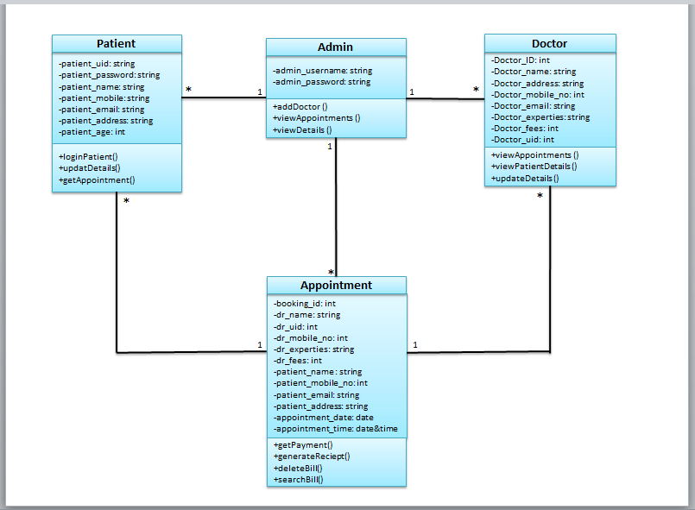
SYSTEM DESIGN AND MODELLING
Class Diagram :-
FIG 4.1.2 : Class Diagram of Doctor Appointment System

Slide 7
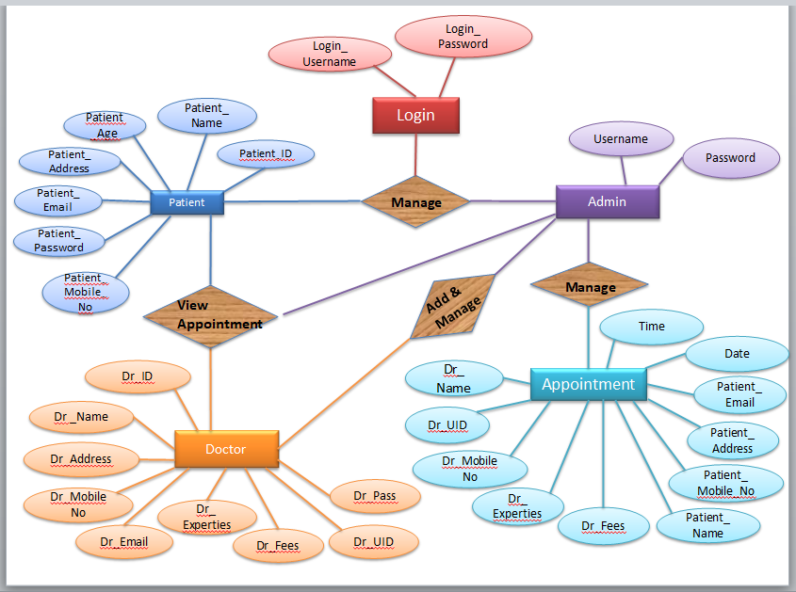
E-R Diagram :-
FIG 4.1.1 : ER Diagram of Doctor Appointment System.

Slide 8
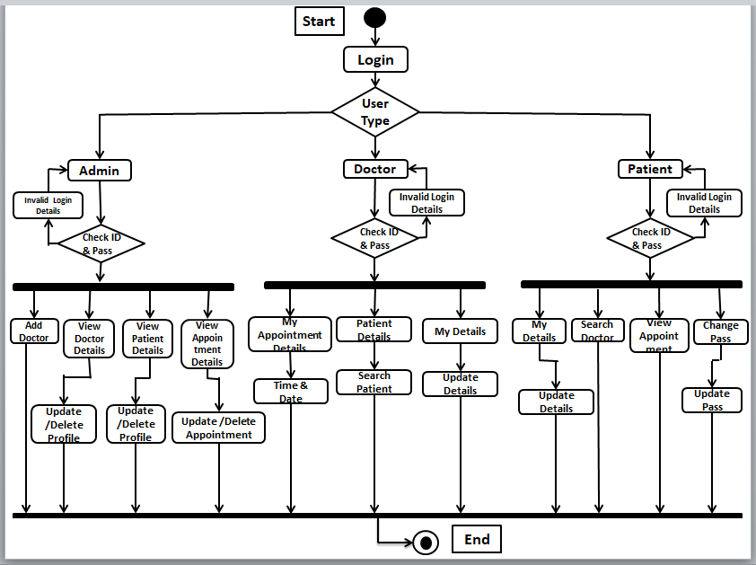
Activity Diagram :-
FIG 4.1.3 : Activity diagram of Doctor Appointment System

Slide 9
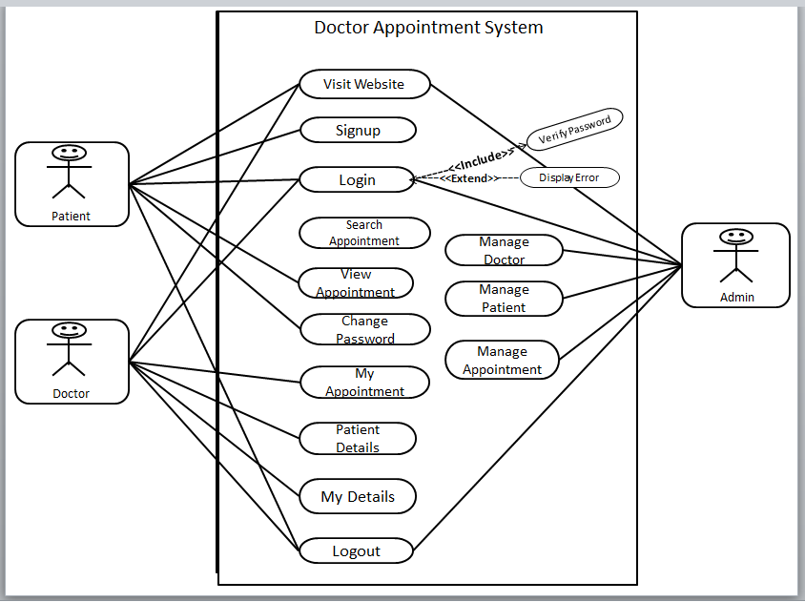
Use Case Diagram :-
FIG 3.1.4 : Use Case diagram of Doctor Appointment System:

Slide 10
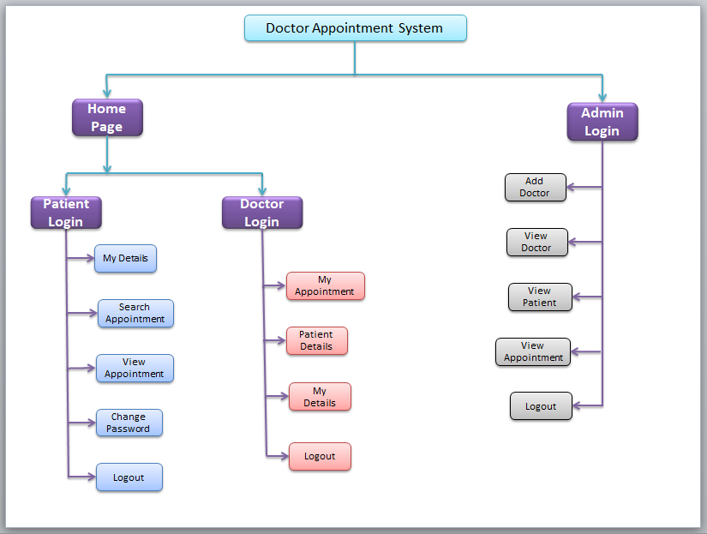
Module Hierarchy Diagram :-
FIG 3.1.5 : Module Hierarchy diagram of Doctor Appointment System.

